Slide 1
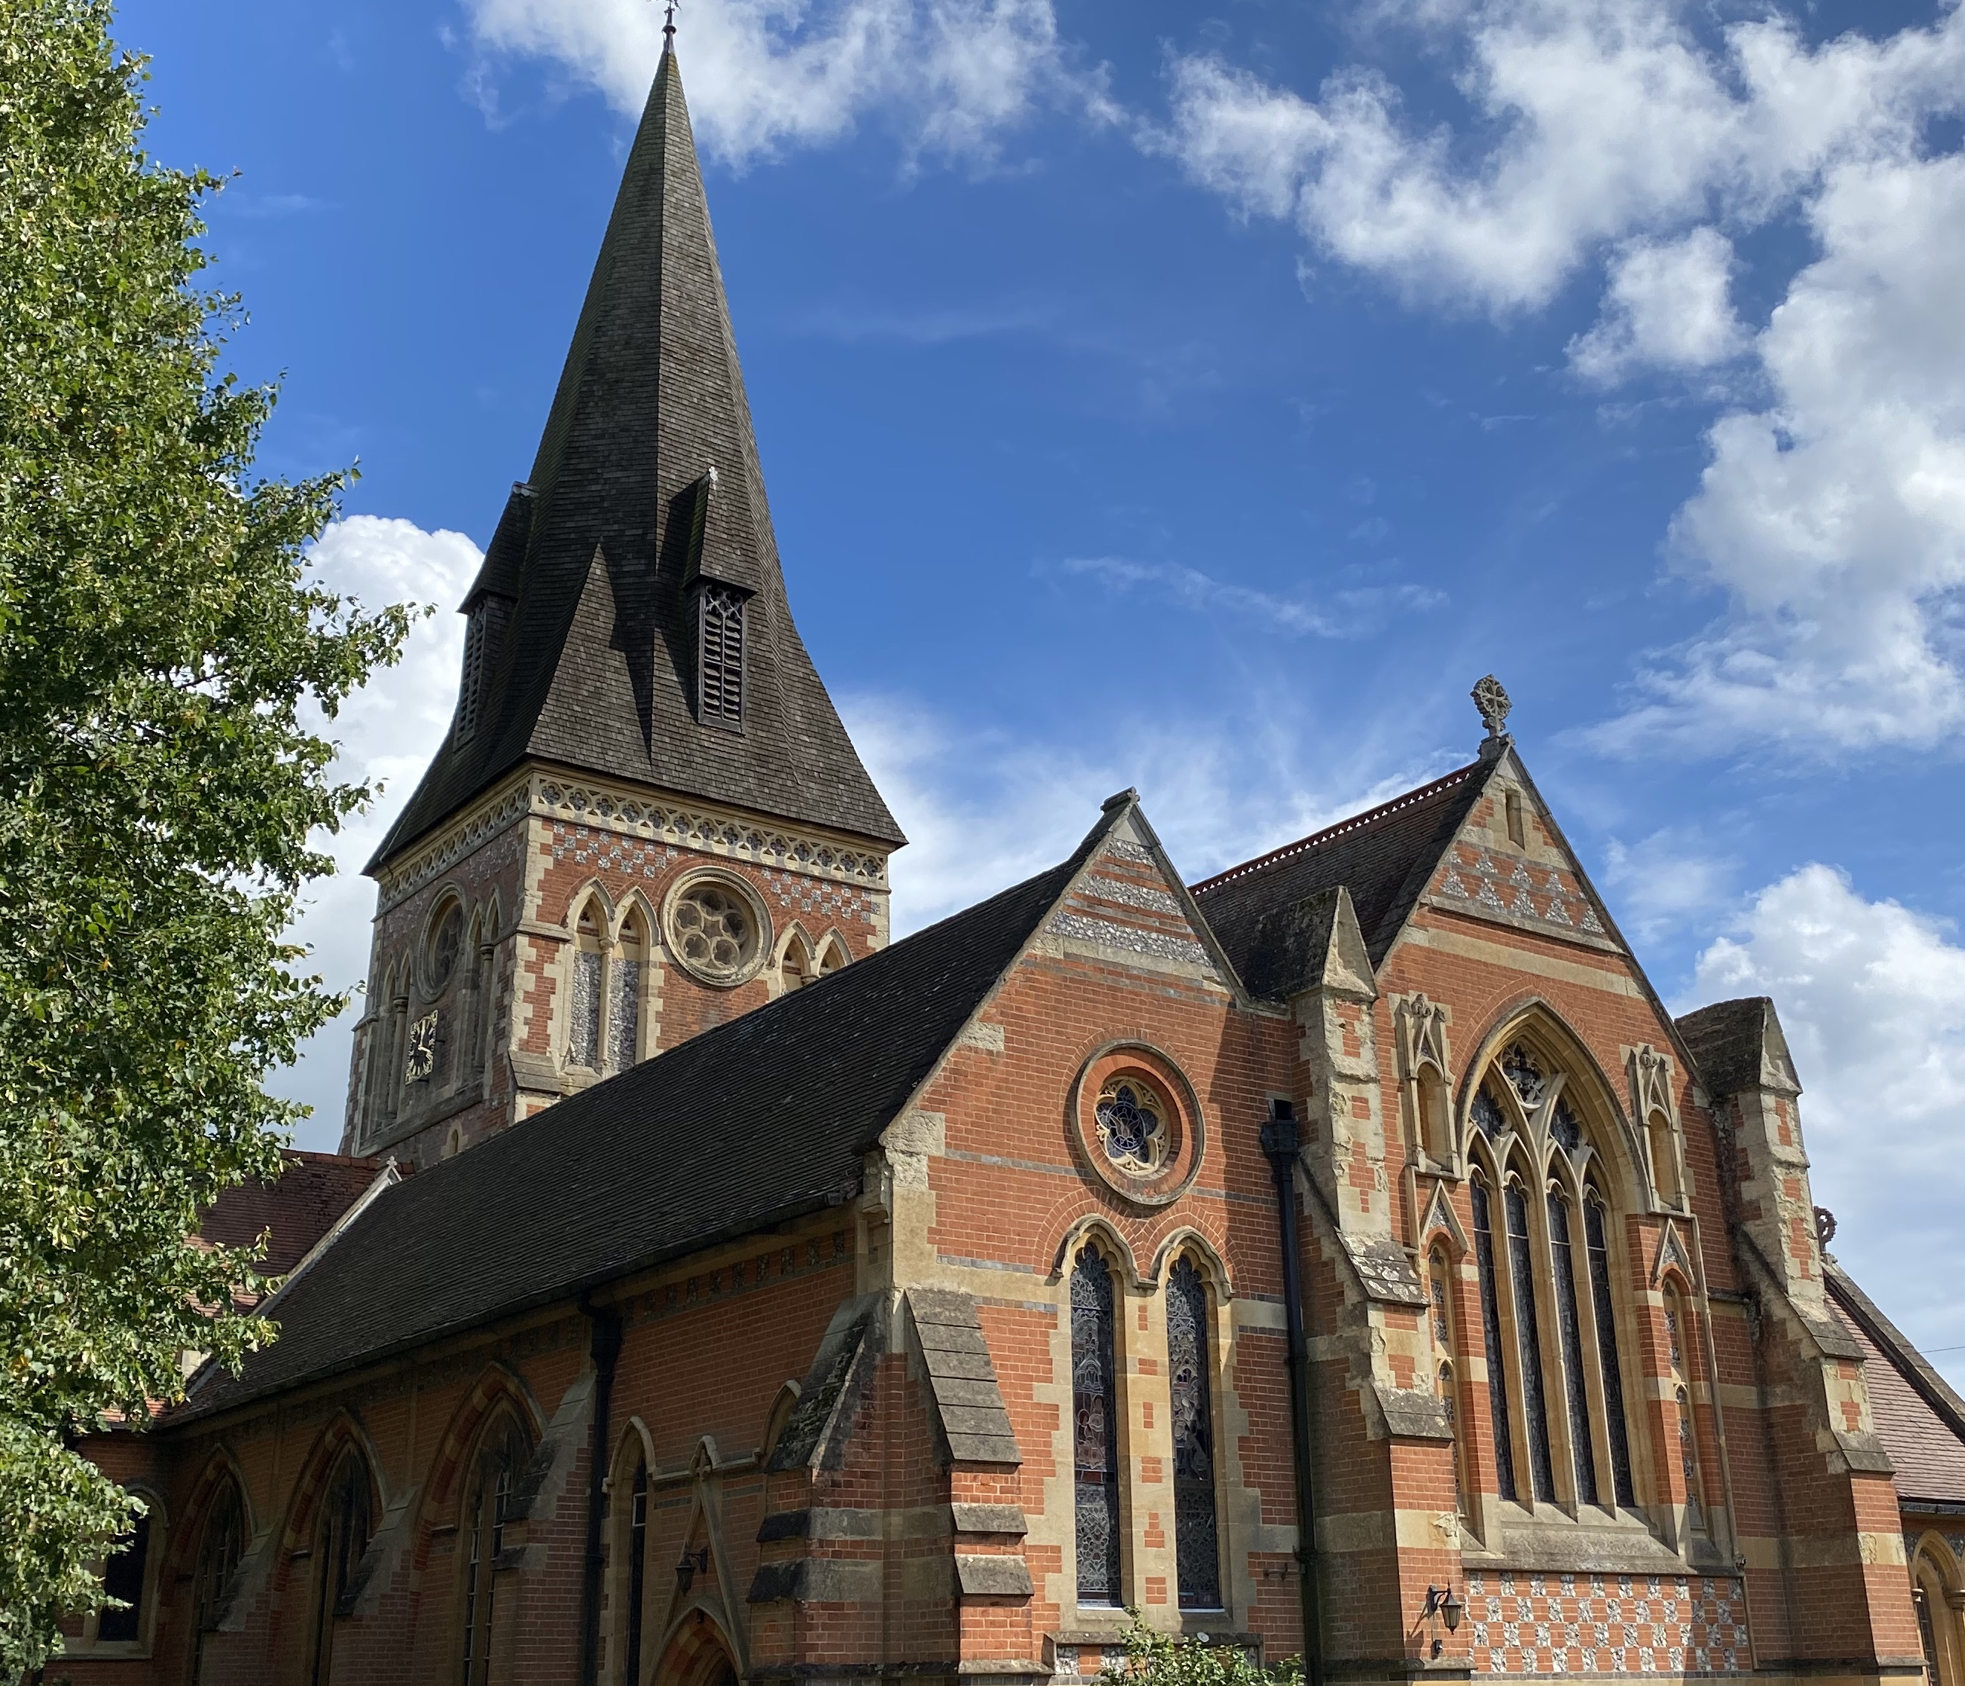
Holy Trinity Sunningdale
Church and Community
Sharing God’s love
5th Sunday of Lent
Transform
Sunday 26th March 2023
To live by faith, to be known by love, to be the light of hope

Slide 2
CAL Child Action Lanka

Slide 3
CAL provides food for over 1000 children attending their centres

Slide 4
They provide a weekly glass of milk for each child with the aim of getting sponsorship to make this daily

Slide 5
CAL provides a mobile school for children on tea plantations that do not attend school

Slide 6
CAL works with the poorest families who live in make shift buildings

Slide 8
I spend time in the special needs unit where 3 girls with CP were carried to school by their Mums. The one wheel chair was broken and fitted under this tin ledge

Slide 9
The group were going to visit the other centres, but I felt my mission was to stay in Kandy and use my skills there

Slide 10
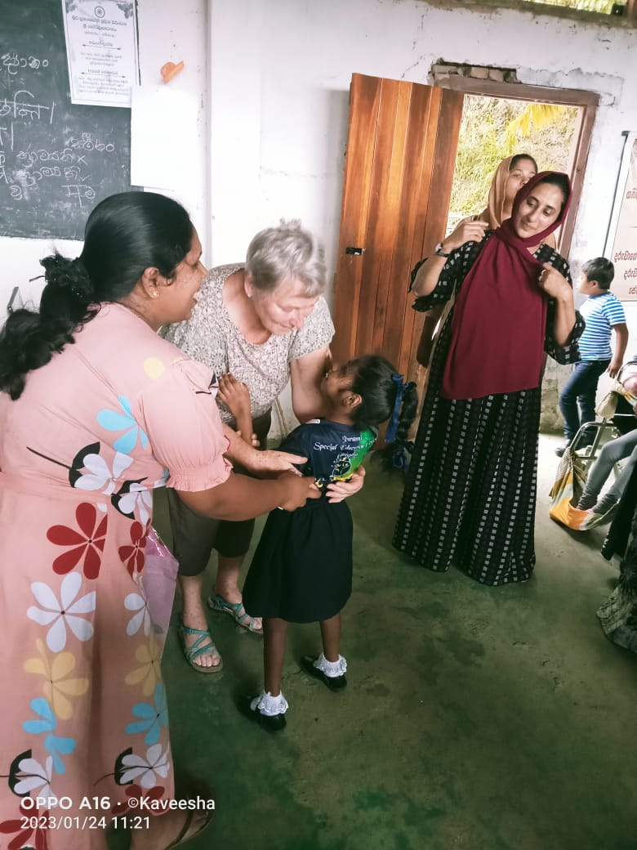
I repacked all the resources and headed back to Kandy to the special needs unit

Slide 11
We created a team, I teacher, I assistant and a fabulous mum and made a plan to sort and clear and set up ‘A Learning Centre’

Slide 12
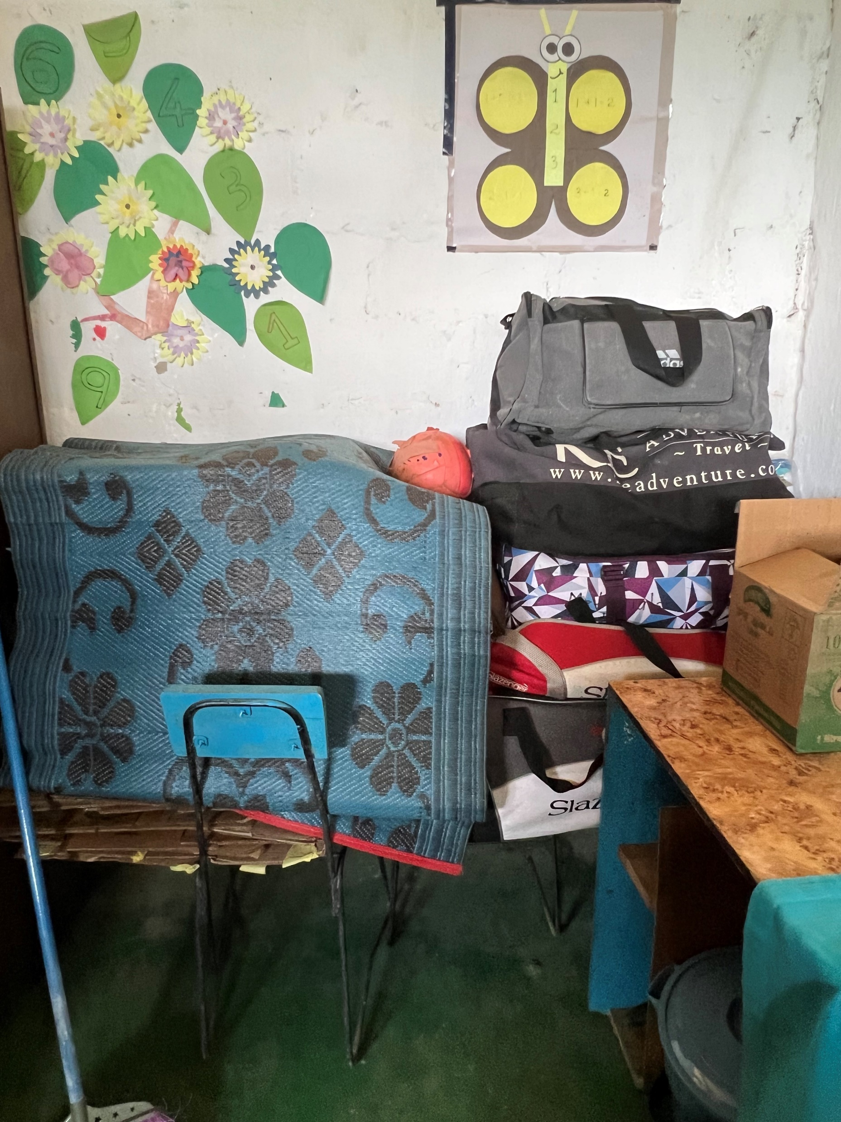

Slide 13
The building was used by Monks in the afternoon and we had to pack and clear everyday. A gift of bats and balls changed our relationship and we rearranged the room.

Slide 14
We set up a ‘tea’ table for parents

Slide 15
Made age appropriate areas

Slide 16
Taught the parents fun games and then handed the activity over to them to run

Slide 18
I introduced story massage and asked parents to run these sessions

Slide 19
CAL was so pleased with the enthusiasm of the team they appointed them to permanent positions-Headteacher, Senior Teacher and Support Assistant

Slide 20
Because the project was now viable, CAL has rented a new building-

Slide 21
And now a new wheelchair would make such a difference

Slide 22
Will you let the blinded see
if I but call your name?
Will you set the pris’ners free,
and never be the same?
Will you kiss the leper clean
and do such as this unseen,
and admit to what I mean
in you, and you in me?

